Slide 1
Can I be your friend
Notes:
Welcome and intro

Slide 2
Current issues impacting on child safety in secondary schools
Local secondary schools tell us that they handle e-safety issues on a daily and often hourly basis.
Some of these problems are filtering down into primary schools.
The next few slides give some examples . Please then read the rest of the presentation and watch the linked films to find out how best to protect your family.
Thaxted School runs a yearly Awareness Session for parents and carers, so keep an eye out for the next one.

Slide 3
Inadequate privacy settings can be utilised by paedophiles to initiate non-contact sexual abuse. The victim’s contact lists and photos can then be used to widen the circle of possible victims.

Slide 4
* Exchange of intimate photos or videos via text, social media sites and webcam.
- Images are often spread wider than intended recipient including outside of school and can lead to bullying and
self-harm.

Slide 5
* Sites like You tube and teenage interest sites may be used by predatory paedophiles who feign similar interests to gain a young person’s trust.
* Underage use of apps coupled with a lack of privacy settings.
- Leads to randomly distributed pornographic material via sites such as Kik.

Slide 6
* Video chat websites that offer free, unregistered chat to strangers.
- Frequently seen – inappropriate behaviour.

Slide 7
* The forming of relationships with inappropriate adults.
- Girls can be susceptible to flattery about their looks.
- Boys may be susceptible to flattery about their sporting or gaming ability or lured with gaming ‘cheats’.

Slide 8
Why you should keep your personal information safe on-line.

Slide 9
Sites children might use....
The age at which children access games and sites like Minecraft, Youtube Instagram, Kik and Facebook etc., originally aimed at teenagers and adults, is increasingly younger.
Younger children are often on sites like CBEEBIES, Moshi,
Club Penguin, Moviestar, Bin Weevil, Weevil.
Facebook is now ‘old hat’ and many newer apps and sites, many with webcams, have fewer privacy safeguards.
No registration video chat sites, often used by celebrities which increases the appeal. Primary school children are regularly seen, in their bedrooms, in school uniforms, certificates and photos in view.

Slide 10
Not just stranger danger....
Grooming
Pornography
Violent images
Gambling
Bullying
Extreme ideas

Slide 11
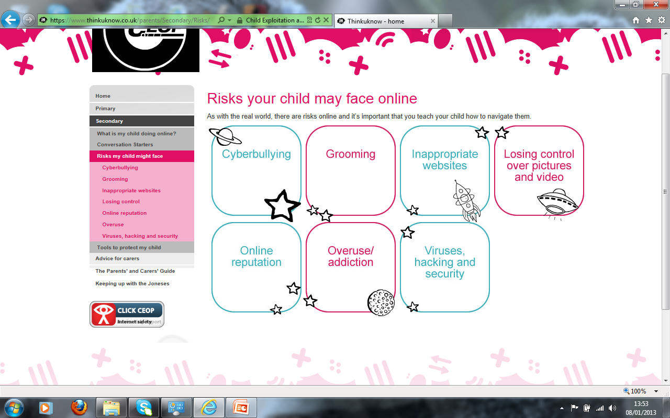
What is online grooming?
What does an online friend mean to your child? Is it the same for you?
Risks Children Face Online (Grooming)

Slide 12
Stranger Danger – Top Tips
Look out for a change in level of internet use.
Has your child become more secretive?
Discuss the definition of a stranger.
Talk to your child about:
  Grooming and what it means
  meeting online friends in the real world and what they should do if someone asks to meet them.
  Online friends, who are they chatting with/sharing information with
  What type of information they’re sharing
Let your child know you are always there for support
Learn how to report inappropriate contact.

Slide 13
What is Cyberbullying?
How and where can you be Cyberbullied?
https://www.youtube.com/watch?v=5yVE0XszE3A

Slide 14
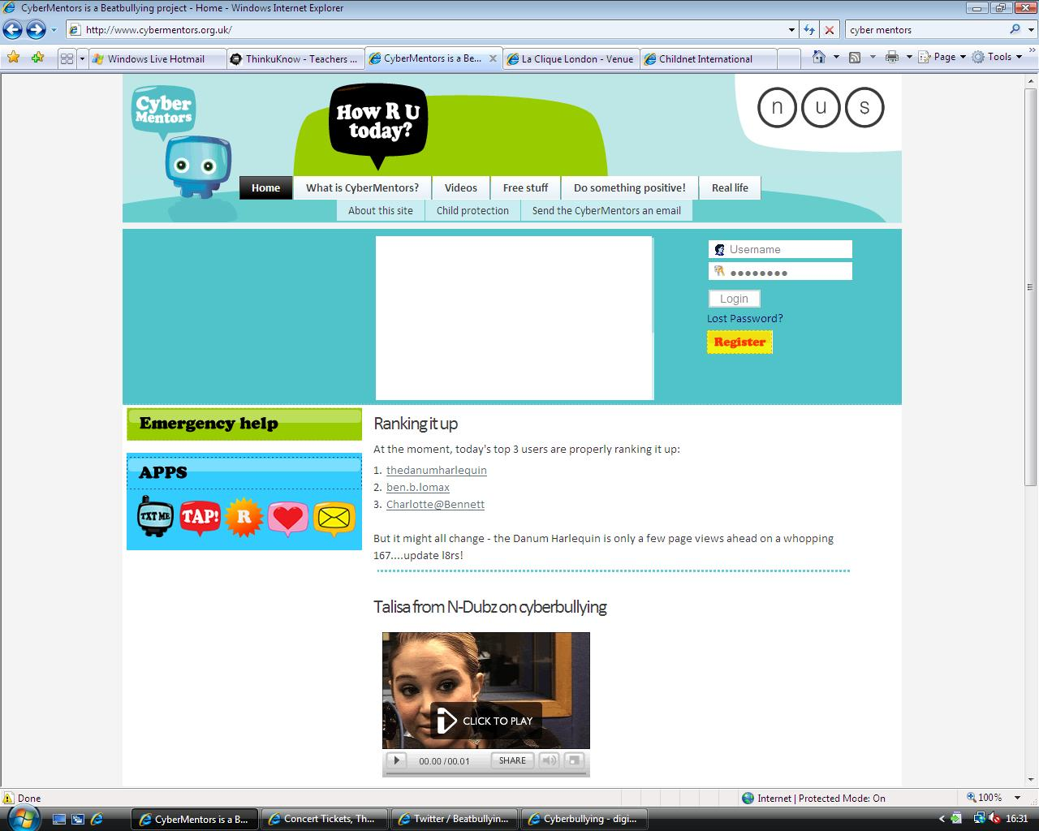
Cyberbullying Top tips
Offer reassurance and support. Don’t be afraid to ask questions
Tell your child that if they are being bullied to always keep the evidence
Block the bullies
Learn how to report and where to go for further support
Peer to peer support network for young people who are being bullied
www.cybermentors.org.uk

Slide 15

Selfies
Sending nude images is an huge problem in secondary schools leading to bullying, blackmail and exploitation.
Save face – use ZIPIT on Childline – humorous image – no nudity.
Notes:
Key Selfie Facts

Slide 16
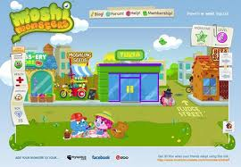
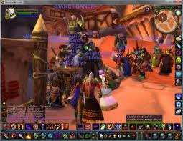




Gaming
Even very young
children are gaming
now, either online
or using consoles..
Many online games and game consoles
allow users to link to thenternet and
play and communicate against other
users all over the world.
The same e-safety checks and rules should apply.
It is very easy to
pretend to be someone
you’re not and to strike
up a relationship.

Slide 17
Mobile Technology – Top Tips!
Treat mobiles, IPads etc. as mini computers and set
age appropriate controls.
The same safety measures should be put in place.
Search for your contract provider or phone type
plus ‘parental controls’
See the OfCom guide.
Make sure the apps children are using are age
appropriate.

Slide 18
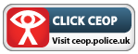

Report and Support
Report suspected online grooming – this could sexual chat, a child being asked to do something that makes them feel uncomfortable or someone insisting on meeting up.
www.ceop.police.uk
Call the police if a child is at immediate risk.
24 hour confidential helpline for children and young people .

Slide 19
Parental Controls
Set controls on:
Computers
Laptops
Tablets
Mobile devices
Games Consoles
ALL internet enabled devices
Set on all devices that link to the internet
Remember… they are not 100% accurate and not a substitute for open communication!

Slide 20
Parental controls
  Block sites that are not age appropriate
  Limit inappropriate and illegal material
  Set timings – automatic switch off at bedtime
  Monitor activity
  Understand that you cannot block everything, particularly as your child gets older and therefore talking to your
  child about safety, behaviour and values is very important.
Protect yours and their identity/privacy online.
Passwords - use a nickname.
Use a parent email for any sites such as facebook/flickr
  Discuss the ‘uh-oh’ feeling.
  Ensure children feel they can talk to you if they’ve made a ‘mistake’ on line.

Slide 21
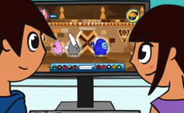
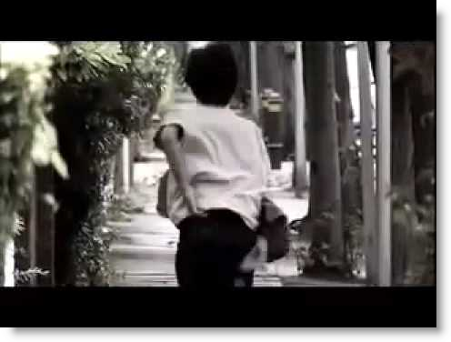
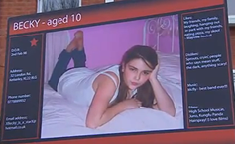
Conversation starters….
To start the conversation with your child, why not view age appropriate animations and films at - www.thinkuknow.co.uk/parents
www.youtube.com/ceop
5-7
Lee and Kim’s Adventure: Animal Magic
Animation – Be nice to people,
like you would in the playground
Tom’s Story – 11 +
about gaming and
meeting online
‘friends’
8-10
Jigsaw
10 minute film about
Safe Social Networking

Slide 22
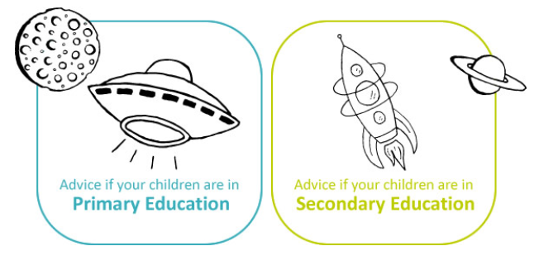
For more information…
www.thinkuknow.co.uk/parents
http://ceop.police.uk/
http://consumers.ofcom.org.uk/2009/10/parental-controls-for-mobile-phones/
http://www.childline.org.uk/Pages/Home.aspx

